Slide 1
Traffic Modelling System
Team:
Roopanadha Moori
Sahil Nokhwal
Ashwini Cherukuri
Ram Naveen Kommuri
Sai Teja Naraharasetty
Bobba Vamsy Chowdary
Nomula Manikanta

Slide 2

Client and Mentor
Client & Mentor: Dr. Michael Oudshoorn
Associate professor in the School of Computer Science and Information System

Slide 3
Outline
Project briefing
Project Requirements
Test Plan
Evaluation of our project

Slide 4
Project briefing
Now-A-days traffic is a main problem. This is caused due to different reasons.
One of the reasons may be deploying the wrong setup of roads.
So making a traffic study and choosing the correct type of road at a particular situation will help to reduce the traffic issues.

Slide 5
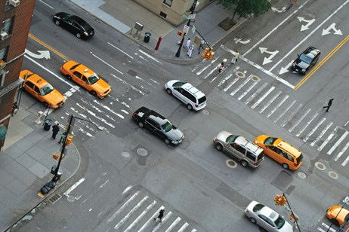
Project Overview (Contd..)
One of the basic goals of studying traffic is to understand traffic congestion and look for ways to prevent it.
The goal is to provide efficient movement of traffic while minimizing congestion problems.

Slide 6
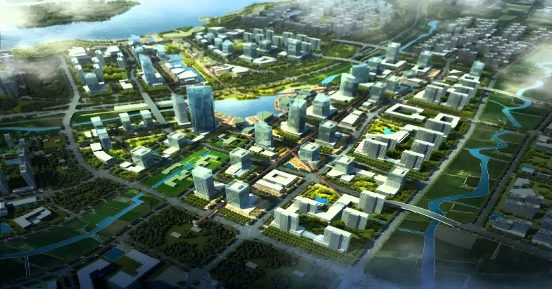
Project Overview (Contd..)
Developing a traffic modelling system can also be used in city planning.
It also help to improve environment by preventing unwanted traffic which will reduce both release of CO2 and chances of vehicle collision

Slide 7
Project requirements
The user should be able to simulate different types of roads which include 2-ways, 4-ways, roundabouts, traffic signals and T-junction.
The user should be able to drag and drop the roads on to the simulation panel.
He should be able to change the alignments of roads.
The user should provide the below details regarding
Arrival rate.
Speed limit of the road
Number of cars that should turn in each direction
Number of cars that should generate in each direction.

Slide 8
Project requirements
Car behavior requirements
Should avoid accidents.
Should accelerate when there is no car in front.
Should decelerate when there is a stop sign or if there is any car in front.
Should take directions based on the values provided by the user at different intersections.
Should be generated according to the arrival rate.
Should be dumped after exiting the simulation.
Should maintain some buffer distance between other cars.

Slide 9
Project requirements
Car behavior requirements(continued)
Should display the speed of the car.
Should follow the traffic signals and signs.
Road requirements
Should have stop signs and signals as mentioned.
Should have a speed limit to the road.
Placement of T-junction should be checked.

Slide 10
Test plan
Purpose of test plan
The objective of the test is to verify that the functionalities of Traffic Modelling System works according to the specifications.
This test plan includes execution, identification, and fixing all high and medium severity defects and low severity defects are given the least priority.

Slide 11
Core features to be tested
Car direction selection and arrival rate.
Car acceleration and deceleration.
Car stopping at the signals and stop signs.
Car maintaining the buffer distance.
Car behavior at the intersections.
Validations of the input.

Slide 12
Test Approach
We followed the functional testing approach.
We first performed unit testing on each module and fixed the issues if found any.
Then we performed integration testing by integrating logically related modules.
Then we performed the whole system testing which is nothing but the whole project testing.
We performed all these testing's by inputting different situations and finding the outputs.

Slide 13
Evaluation of the project
With respect to the requirements we have almost reached 90% of our requirements.
We are behind our schedule by 200 hours at some point of time but we managed to pinch that difference to 50-70 hours.
We are also able to perform all the core functionalities in our project.
At this particular point of time we need to fix some issues and perform critical system testing.
We will discuss the main things we have achieved and not achieved briefly in this presentation.

Slide 14
Evaluation of our project
Requirements | Evaluation
Traffic simulation | Achieved
Simulation of all types of roads | Achieved
Drag and Drop | Not Achieved
2D- layout | Achieved
Rearranging of roads | Not Achieved

Slide 15
Evaluation of our project
Requirements | Evaluation
Road Speed limits | Not Achieved
Functionality of signal | Achieved
Car acceleration and deceleration | Achieved
Car Direction selection according to user input | Achieved
Avoid Accidents | Achieved

Slide 16
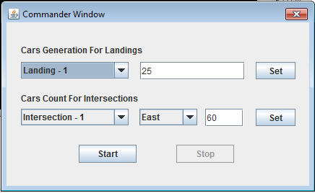
Working of our project
Running of our project will first give the user to input the values.

Slide 17
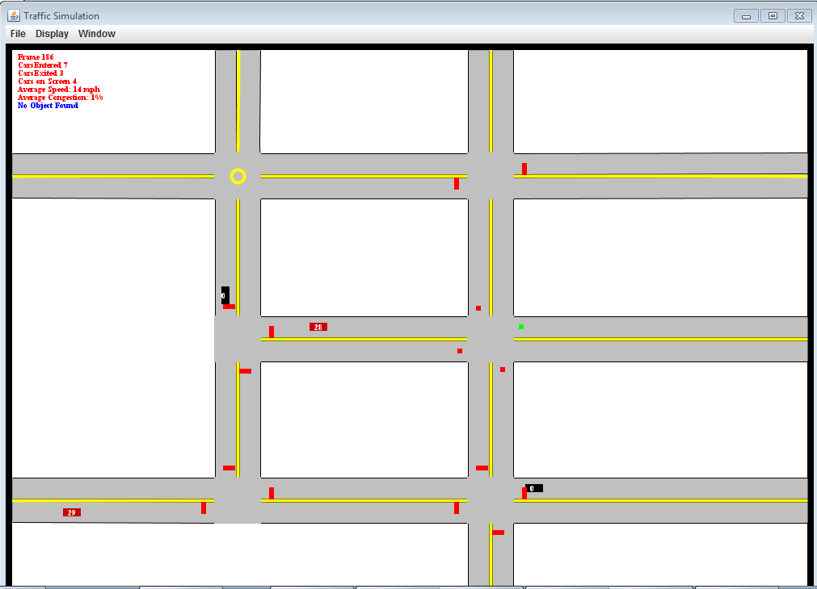
Working of our project

Slide 18
Demo

Slide 19

Any Questions?

Slide 20


